Slide 1
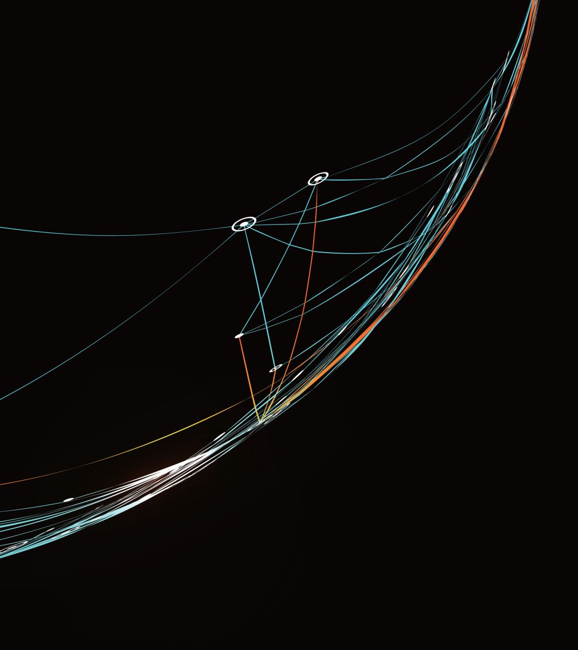
Fire Detection AI
Capstone Project
Student: Wenping Wang
Professor: Macros Bittencourt

